Slide 1
Database Management Systems
Basic SQL Operations
KIET Group of Institution

Slide 2
Contents
Create Table Construct
Updates to Tables
Basic Query Structure
The select Clause
The where Clause
Rename operation

Slide 3
Relational Database Concept
  RDBMS stands for Relational Database Management System. RDBMS is the basis for SQL, and for all modern database systems like MS SQL Server, IBM DB2, Oracle, MySQL, and Microsoft Access.
  The relational model consists of the following:
    Collection of objects or relations
    Set of operators to act on the relations
    Data integrity for accuracy and consistency

Slide 4

Relation or Table
The Entity information in RDBMS is stored in database objects called tables. The table is a collection of related data entries and it consists of columns and rows.

Slide 5
Components of table
Attribute/Column/Field: The characteristics of entity are called attribute.
The values of these attributes are called Attribute values.
Tuple/Record/Row: The value of multiple fields placed in the horizontal plane.

Slide 6
SQL BASICS
SQL is used to communicate with any Relational Database.
Its primary function is to support the definition, manipulation and management of data in relational database.
It provides the syntax and semantics of data definition and manipulation of data.
It also provides an interface for portability of database definition and application programs.

Slide 7
MySQL data Types
Different data types broken into three categories −
Numeric
Date and Time
String Types.
common numeric data types−
INT − A normal-sized integer that can be signed or unsigned. If signed, the allowable range is from -2147483648 to 2147483647. If unsigned, the allowable range is from 0 to 4294967295. You can specify a width of up to 11 digits.
FLOAT(M,D) − A floating-point number that cannot be unsigned. You can define the display length (M) and the number of decimals (D). This is not required and will default to 10,2, where 2 is the number of decimals and 10 is the total number of digits (including decimals). Decimal precision can go to 24 places for a FLOAT.
Other- DOUBLE(M,D), DECIMAL(M,D) DECIMAL(M,D), TINYINT, SMALLINT, MEDIUMINT, BIGINT

Slide 8
common Date and Time Types
DATE − A date in YYYY-MM-DD format, between 1000-01-01 and 9999-12-31. For example, December 30th, 1973 would be stored as 1973-12-30.
DATETIME − A date and time combination in YYYY-MM-DD HH:MM:SS format, between 1000-01-01 00:00:00 and 9999-12-31 23:59:59. For example, 3:30 in the afternoon on December 30th, 1973 would be stored as 1973-12-30 15:30:00.
TIMESTAMP − A timestamp between midnight, January 1st, 1970 and sometime in 2037. This looks like the previous DATETIME format, only without the hyphens between numbers; 3:30 in the afternoon on December 30th, 1973 would be stored as 19731230153000 ( YYYYMMDDHHMMSS ).
TIME − Stores the time in a HH:MM:SS format.
YEAR(M) − Stores a year in a 2-digit or a 4-digit format. If the length is specified as 2 (for example YEAR(2)), YEAR can be between 1970 to 2069 (70 to 69). If the length is specified as 4, then YEAR can be 1901 to 2155. The default length is 4.

Slide 9
common String Types
CHAR(M) − A fixed-length string between 1 and 255 characters in length (for example CHAR(5)), right-padded with spaces to the specified length when stored. Defining a length is not required, but the default is 1.
VARCHAR(M) − A variable-length string between 1 and 255 characters in length. For example, VARCHAR(25). You must define a length when creating a VARCHAR field.
BLOB or TEXT − A field with a maximum length of 65535 characters. BLOBs are "Binary Large Objects" and are used to store large amounts of binary data, such as images or other types of files. Fields defined as TEXT also hold large amounts of data. The difference between the two is that the sorts and comparisons on the stored data are case sensitive on BLOBs and are not case sensitive in TEXT fields. You do not specify a length with BLOB or TEXT.
Other- TINYBLOB or TINYTEXT, MEDIUMTEXT, LONGTEXT, ENUM

Slide 10
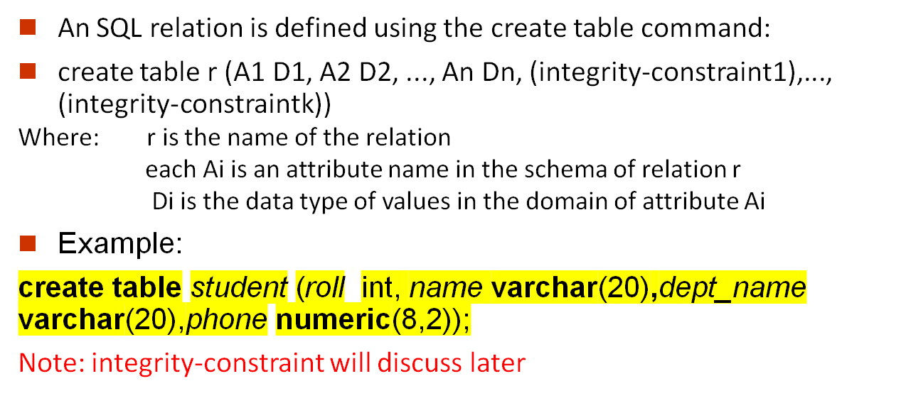
Create Table Construct

Slide 11
Insert
  insert into student (roll,name,add,phon) values (113, ’Smith’, ’Biology’, 66000);
Delete
  Remove all tuples from the student relation
    delete from student ;
    Remove selected tuple
    Delete from student where rollno=123;

Slide 12
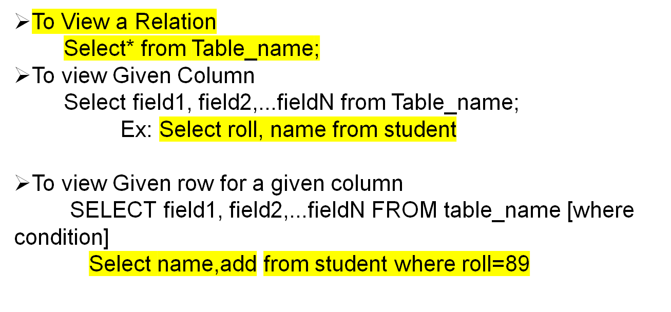
Retrieve Data

Slide 13
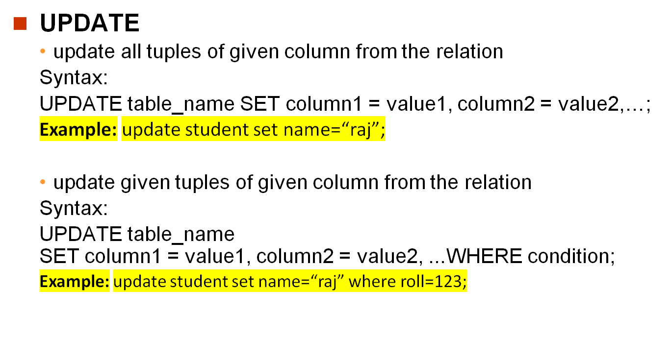

Slide 14
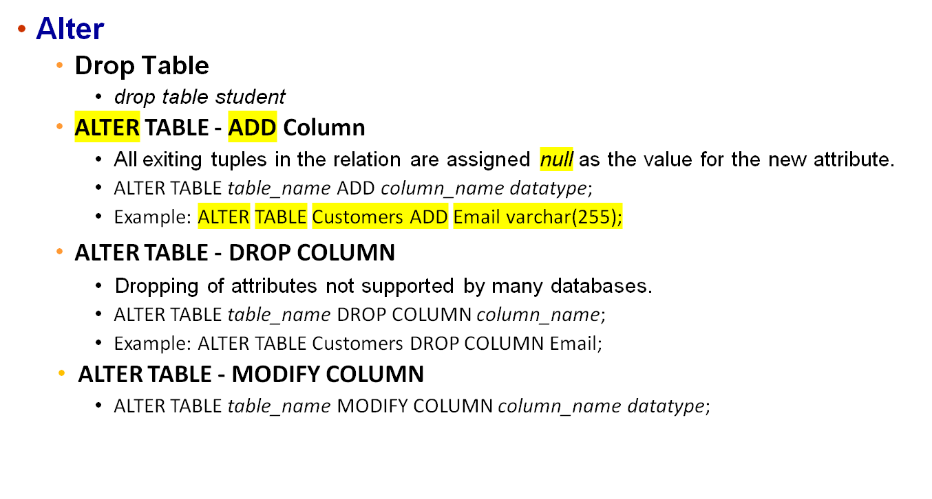

Slide 15
WHERE Condition
SELECT column1, column2, ...FROM table_name WHERE condition;
SELECT * FROM Customers WHERE Country=‘ghaziabad';
SELECT column1, column2, ... FROM table_name
WHERE condition1 AND condition2 AND condition3 ...;
SELECT column1, column2,...FROM table_nameWHERE NOT condition;

Slide 16
SELECT column_name(s) FROM table_name WHERE column_name IN (value1, value2, ...);
SELECT column_name(s) FROM table_name
WHERE column_name IN (SELECT STATEMENT);
SELECT * FROM Customers WHERE Country IN ('Germany', 'France', 'UK');

Slide 17
BETWEEN Operator
SELECT column_name(s)
FROM table_name
WHERE column_name BETWEEN value1 AND value2;
SELECT * FROM Products
WHERE Price BETWEEN 10 AND 20;
SELECT * FROM Products
WHERE Price BETWEEN 10 AND 20
AND CategoryID NOT IN (1,2,3);

Slide 18
REFERENCES
[1] Abraham Silberschatz, Henry F. Korth, and Sudharshan .S,. "Database System Concepts“
[2] http://geeksforgeeks.org/
[3] https://www.w3schools.com/

Slide 19
Thank
You

Slide 20
Today’s Task
Create STUDENT
with column -Roll, name, add, phone
Insert data of 5 students
Display table
Update name of roll 23
Alter table –add column hobby
view
Alter table -drop column roll
view

